Slide 1
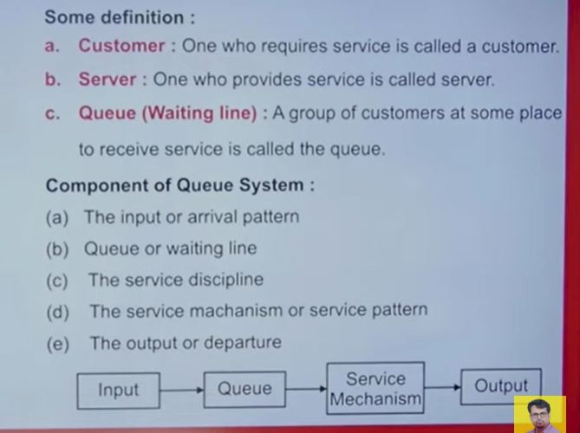

Slide 2
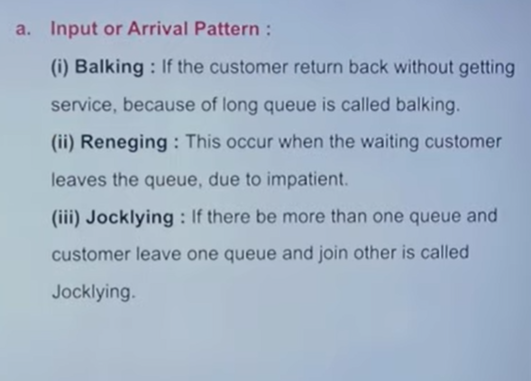

Slide 3
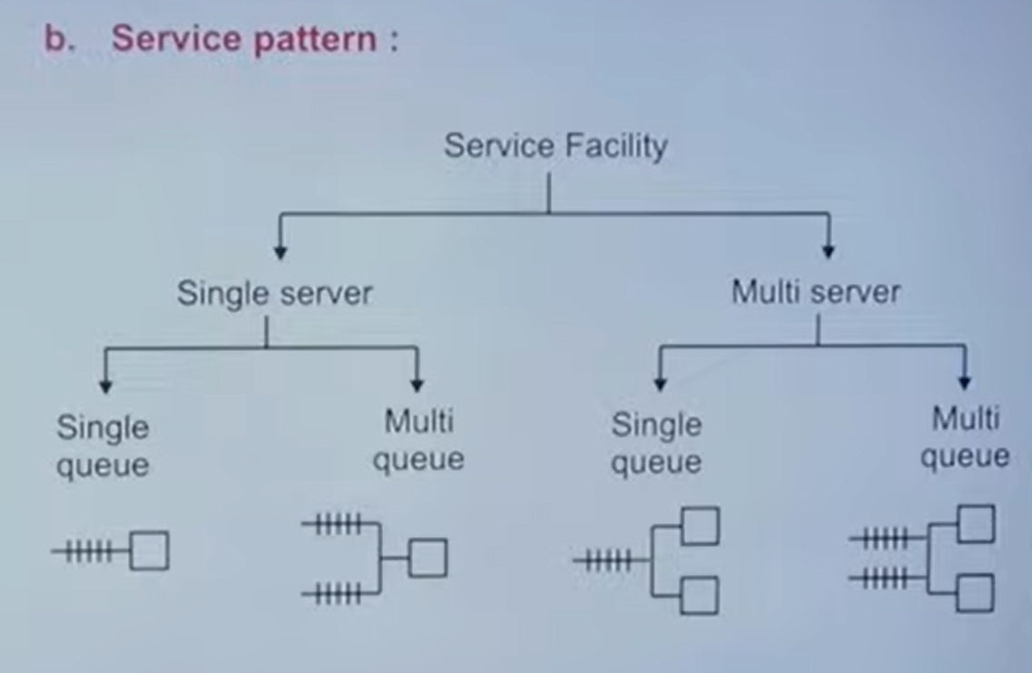

Slide 4
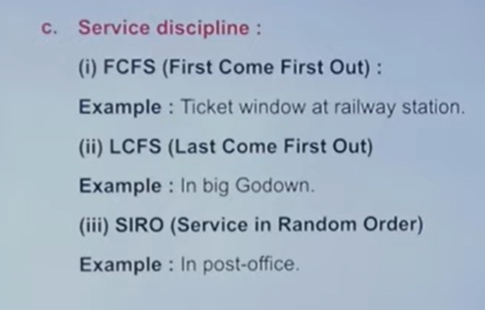

Slide 5
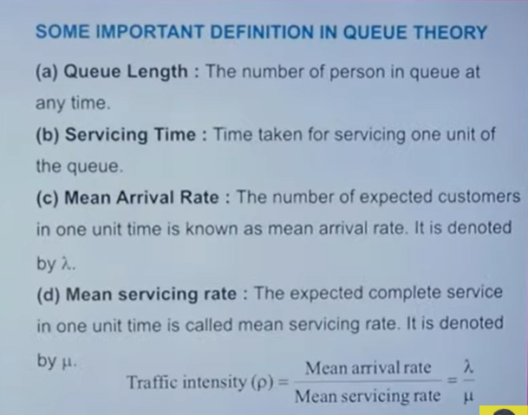

Slide 6
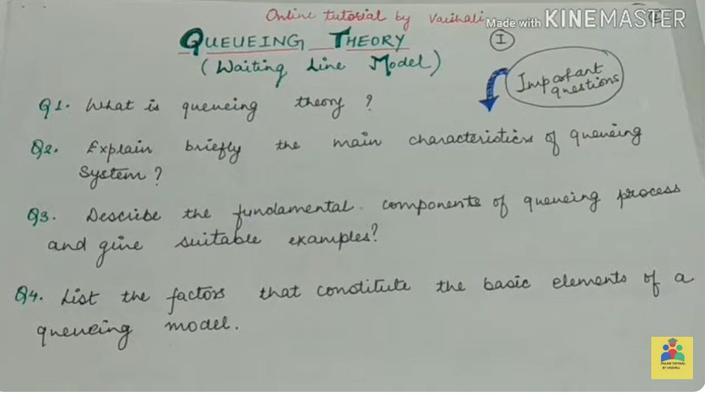
QUEUEING THEORY OR WAITING LINE MODEL

Slide 7
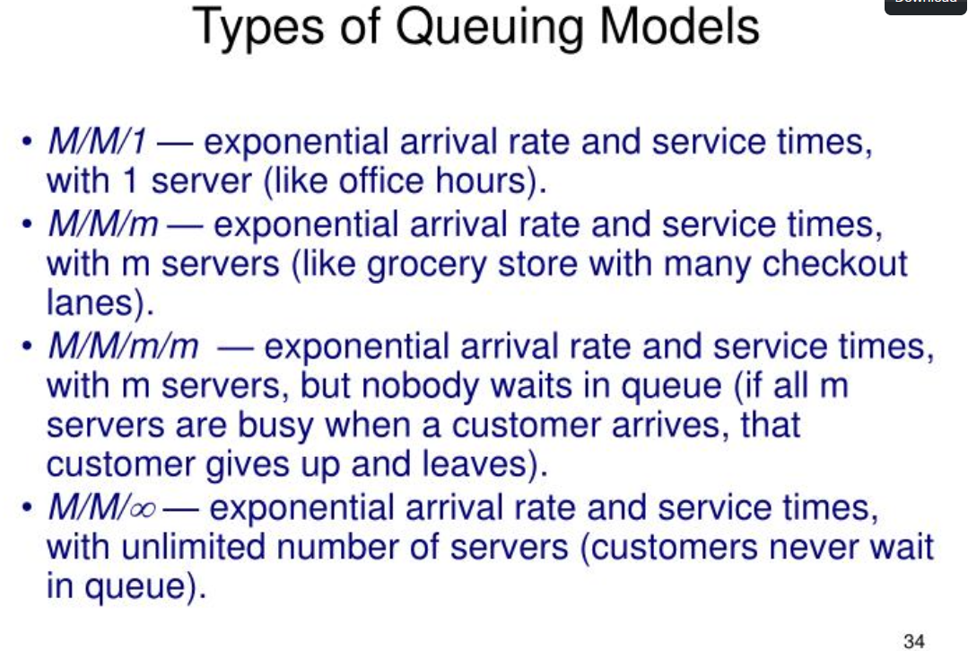
M/M/m/m
Model
M/M/∞
Model
M/M/1
Model
M/M/m
Model

Slide 8
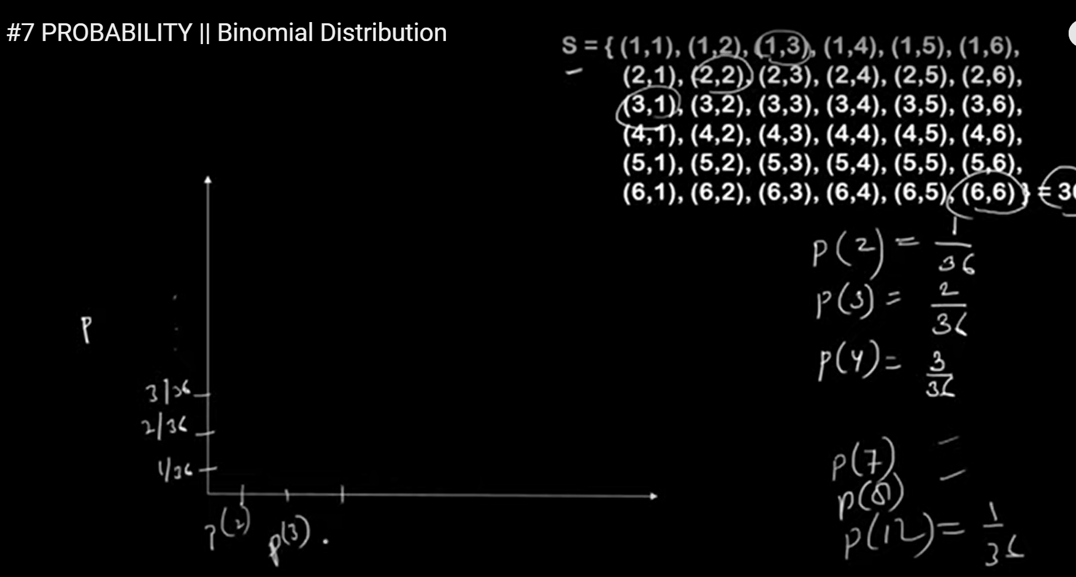

Slide 9
PROBABILITY DISTRIBUTION CURVE

Slide 10
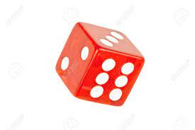
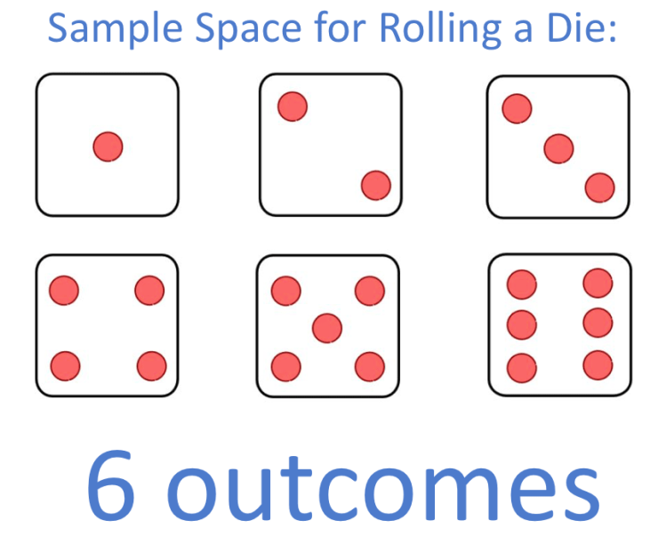

Q: Rolling a Die one time, calculate the Sample Space
SOLUTION
$${Outcomes of Die= 6}^{n}=6^{1}=6$$
Sample Space = $S=\{1,2,3,4,5,6\}$

Slide 11
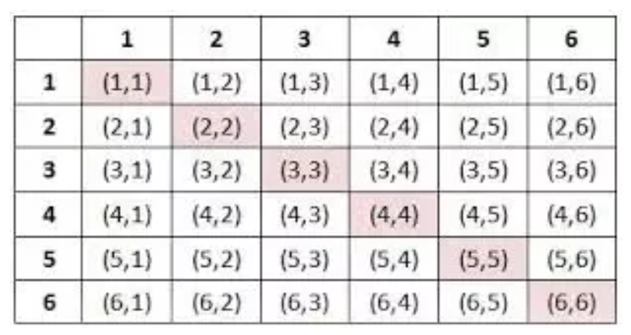

Q: Rolling a Die two times, calculate the Sample Space? OR
Rolling Two Die one time, calculate the Sample Space?
SOLUTION
DIE-1
$${Outcomes of Die= 6}^{n}=6^{2}=36$$
Sample Space = $S=$
DIE-2
When you first time die a roll result appear 1. second time roll a die also appear 1 = (1,1).

Slide 12

Q: When you Rolling a Die two times, find the Probability of that number having sum is 2?
SOLUTION
$${Outcomes of Die= 6}^{n}=6^{2}=36$$
DIE-1
Only one number (1) available in this table which is (1,1) = 1+1 = 2.
DIE-2
$$P\left(2\right)=\frac{1}{36}$$

Slide 13

Q: When you Rolling a Die two times, find the Probability of that number having sum is 3?
SOLUTION
$${Outcomes of Die= 6}^{n}=6^{2}=36$$
DIE-1
Only two numbers (2) available in this table which is (1,2) and (2,1) = 1+2 = 3 or 2+1 = 3.
DIE-2
$$P\left(3\right)=\frac{2}{36}$$

Slide 14

Q: When you Rolling a Die two times, find the Probability of that number having sum is 4?
SOLUTION
$${Outcomes of Die= 6}^{n}=6^{2}=36$$
DIE-1
Only three numbers (3) available in this table which is (1,3) , (3,1) and (2,2) = 1+3 =4, 3+1 =4, 2+2 = 4
DIE-2
$$P\left(4\right)=\frac{3}{36}$$

Slide 15
Probability Distribution
A Probability Distribution is the mathematical function that gives the probabilities of occurrence of different possible outcomes for an experiment.

Slide 16
12/36
11/36
10/36
9/36
8/36
7/36
6/36
5/36
4/36
3/36
2/36
1/36
Draw the Probability Distribution Curve of Rolling a Die two times, having sum is, 2,3, 4, …………?
P(2) P(4) P(6) P(8) P(10) P(12)

Slide 17
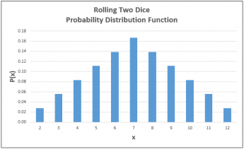
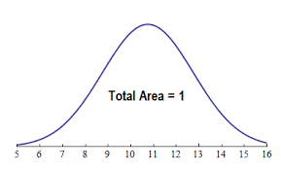
DIFFERENT FORMS OF PROBABILITY DISTRIBUTION CURVES

Slide 18
TYPES OF PROBABILITY DISTRIBUTION
Types of Probability Distribution
Discrete Type Probability Distribution
Continuous Type Probability Distribution
These Distributions values in between 0 and 1.
Binomial Distribution
Poisson Distribution
Normal Distribution

Slide 19
BINOMIAL DISTRIBUTION OR BERNOULLI TRIALS

Slide 20
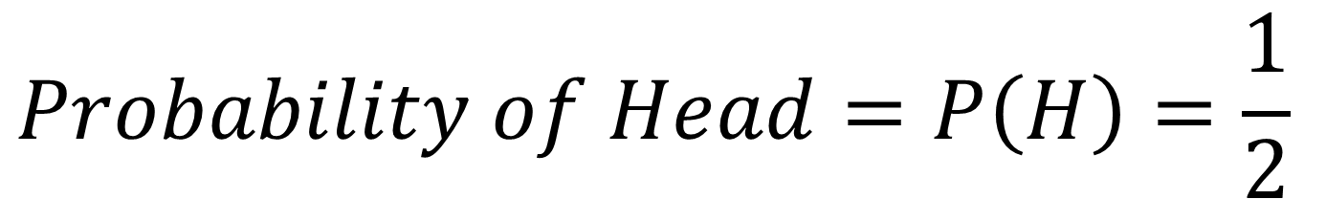
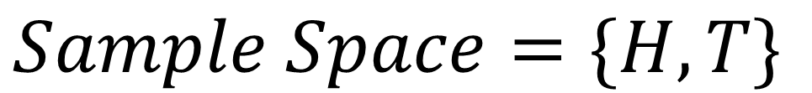
Q: A fair coin is tossed 1 times. What is the probability of obtaining head?
SOLUTION
$$Sample Space=\{H, T\}$$
$$Probability of Head=P\left(H\right)=\frac{1}{2}$$

Slide 21
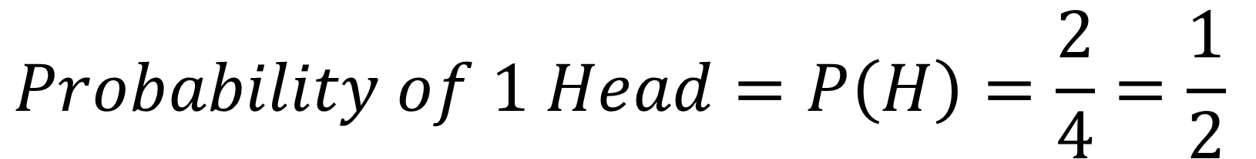
Q: A fair coin is tossed 2 times. What is the probability of obtaining 1 head?
SOLUTION
$$Sample Space=\{HH, HT, TH, TT\}$$
$$Probability of 1 Head=P\left(H\right)=\frac{2}{4}=\frac{1}{2}$$

Slide 22
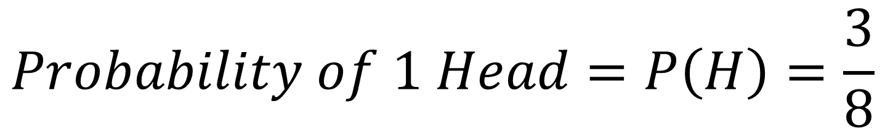
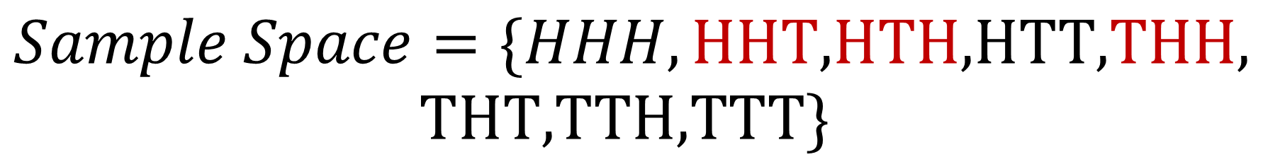
Q: A fair coin is tossed 3 times. What is the probability of obtaining 2 head?
SOLUTION
$$Sample Space=\{HHH,\text{HHT}\text{,}\text{HTH}\text{,}\text{HTT}\text{,}\text{THH}\text{,}$$
$$\text{THT}\text{,}\text{TTH}\text{,}\text{TTT}\}$$
$$Probability of 1 Head=P\left(H\right)=\frac{3}{8}$$

Slide 23
Q: A fair coin is tossed 6 times. What is the probability of obtaining 2 head?
SOLUTION: We can Solve but it takes more time, so Binomial Distribution Provide a solution to use a Formula to Calculate Probability of required heads.

Slide 24
Binomial Distribution
Binomial Distribution is used when number of samples are very large, then we apply Binomial Distribution Formula to Calculate the required Probability.

Slide 25
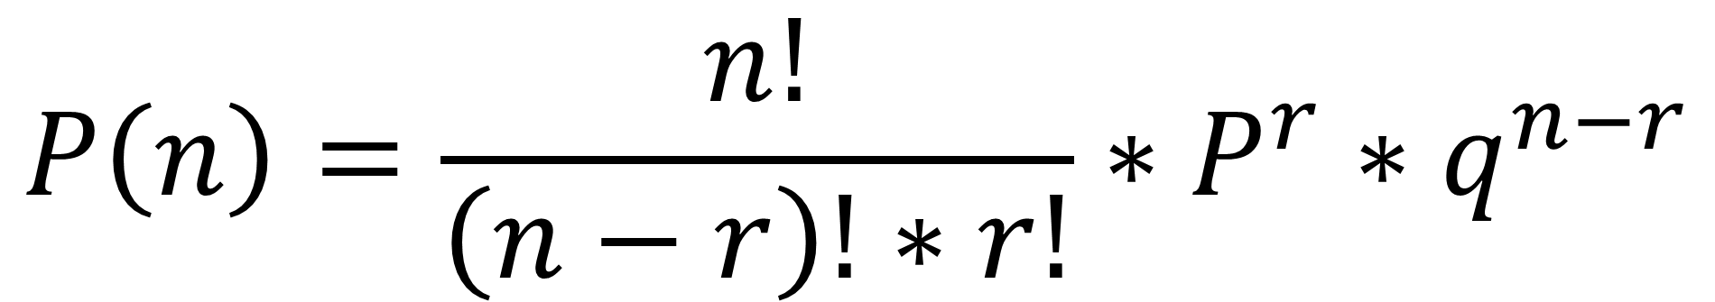
Formula of Binomial Distribution
$$P\left(n\right)=\frac{n!}{\left(n−r\right)!∗r!}∗P^{r}∗q^{n−r}$$

Slide 26

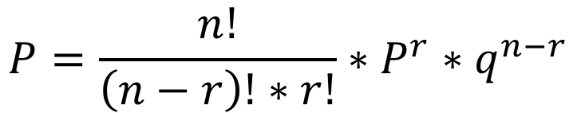

Q: A fair coin is tossed 3 times. What is the probability of obtaining 2 head? Apply Binomial Distribution
SOLUTION
$$tossed times=n=3$$
$$Obtaining Heads=r= 2$$
$$Always P is caculated on One Time tossed to Obtain Head=P=\frac{1}{2}$$
$$Similarly q is caculated as=1 −p=1 −\frac{1}{2}=\frac{1}{2}$$
$$P=\frac{n!}{\left(n−r\right)!∗r!}∗P^{r}∗q^{n−r}$$
$$P\left(2H\right)=\frac{3!}{\left(3−2\right)!∗2!}∗{\left(\frac{1}{2}\right)}^{2} ∗{\left(\frac{1}{2}\right)}^{3−2}=\frac{3∗2∗1}{\left(1\right)!∗2∗1}∗{\left(\frac{1}{2}\right)}^{2} ∗{\left(\frac{1}{2}\right)}^{1}=\frac{3}{8}Ans$$

Slide 27

Q: A fair coin is tossed 6 times. What is the probability of obtaining 2 head? Apply Binomial Distribution
SOLUTION
$$tossed times=n=6$$
$$Obtaining Heads=r= 2$$
$$Always P is caculated on One Time tossed to Obtain Head=P=\frac{1}{2}$$
$$Similarly q is caculated as=1 −p=1 −\frac{1}{2}=\frac{1}{2}$$
$$P=\frac{n!}{\left(n−r\right)!∗r!}∗P^{r}∗q^{n−r}$$
$$P\left(2H\right)=\frac{6!}{\left(6−2\right)!∗2!}∗{\left(\frac{1}{2}\right)}^{2} ∗{\left(\frac{1}{2}\right)}^{6−2}=\frac{6!}{\left(4\right)!∗2!}∗\left(\frac{1}{4}\right)∗{\left(\frac{1}{2}\right)}^{4}=\frac{15}{64} Ans$$

Slide 28
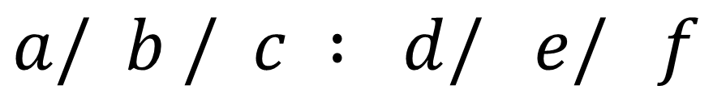

KENDALL’S NOTATIONS
$$a/ b / c : d/ e/ f$$
$$a=Arrival \{Followed by Poisson Distribution\}$$
$$b=Service \{Followed by Exponential Distribution\}$$
$$c=Number of Servers$$
$$d=Queue Discipline (FIRST COME FIRST SERVE, LCFS)$$
$$e=Length of Queue (∞,N)$$
$$f=Population Source (∞, N)$$

Slide 29
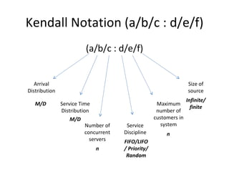

Slide 30
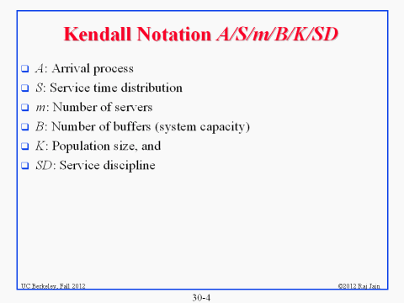

Slide 31
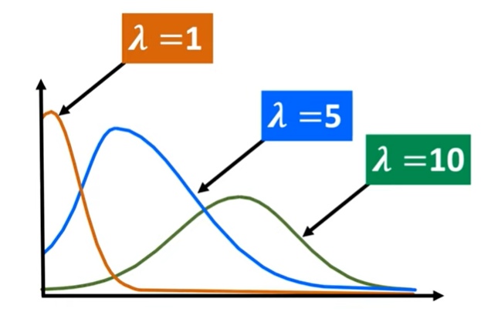

Slide 32
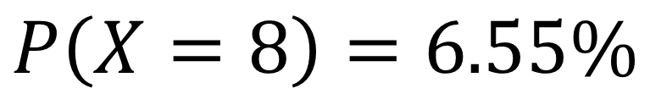
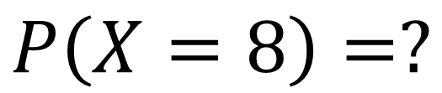
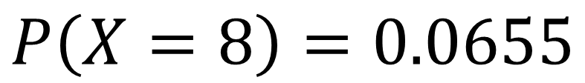
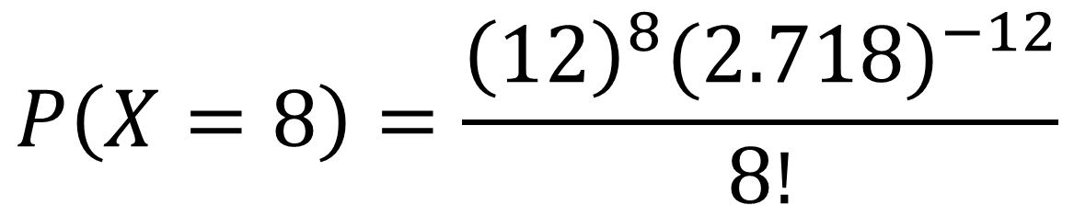
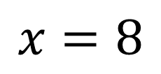
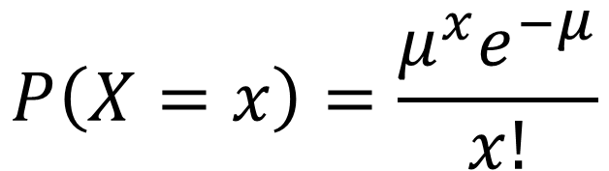
A small business receives an average 12 customers per day. (a) What is the probability that the business will receives exactly 8 customers in one day?
SOLUION
$$Average customers= μ= 12$$
$$x=8$$
$$P\left(X=8\right)=?$$
$$P\left(X=8\right)=0.0655$$
$$P\left(X=x\right)=\frac{μ^{x}e^{−μ}}{x!}$$
$$P\left(X=8\right)=6.55\%$$
$$P\left(X=8\right)=\frac{{\left(12\right)}^{8}{(2.718)}^{−12}}{8!}$$

